Slide 1
Opinion Mining Social Web for Calculating Desirable Specifications for Products
GUIDED BY
Dr. Viji Rajendran V

Slide 2
Proposed Model
Our proposed model consist of 3 key components:
A Social Web Miner to extract subjective texts about a product from twitter using hashtags.
An Opinion Mining System to compute polarity and sentiment value using NLP.
A Machine Learning Model to calculate desirable specification based on the output from Opinion Mining and some input constraints.

Slide 3
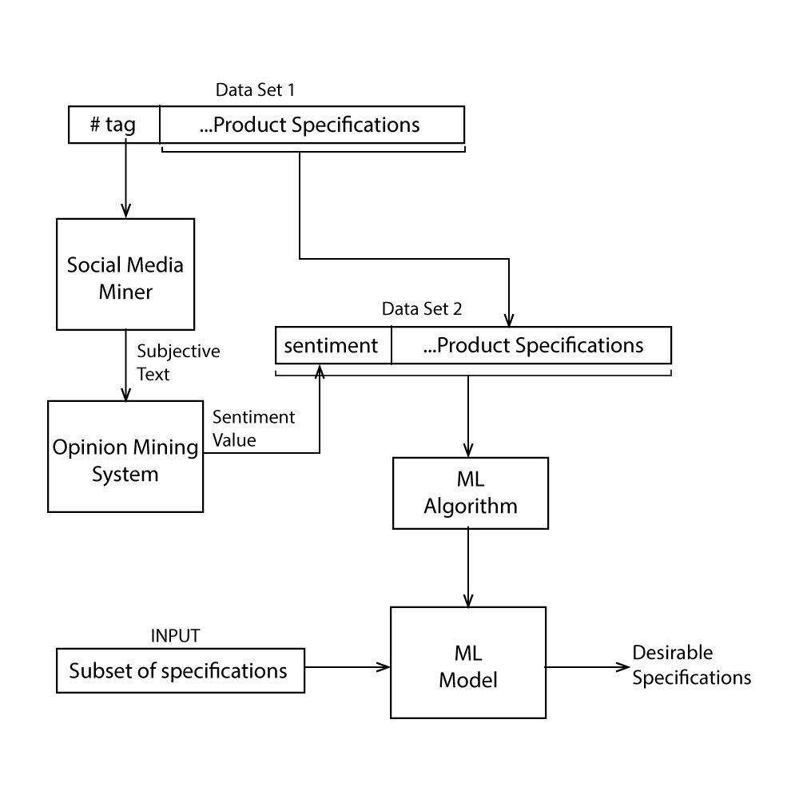

Slide 4
SYSTEM DESIGN
Social Web Miner
Uses Twitter API to query tweets using hashtag.
Extracts the text from tweet and preprocess it for sentiment analysis.
Opinion Mining System
Uses TextBlob python library for sentiment analysis.
Creates a TextBlob from preprocessed tweet and finds subjectivity and sentiment value.
Finds the average sentiment value of all the tweets that has a minimum subjectivity.

Slide 5
SYSTEM DESIGN
Machine Learning Model
Uses Pandas to handle datasets.
Uses SciKit learn for building machine learning models.
Combines average sentiment polarity and product specification to build a dataset for training the model.
Uses Multivariate Multiple Regression to calculate desirable specification for a new product.

Slide 6
THANK YOU

